Slide 1
Explainable Machine Learning
Hung-yi Lee 李宏毅

Slide 2
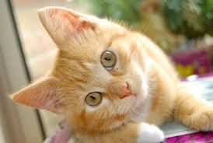
Explainable/Interpretable ML
This is a “cat”.
Because …
Classifier
Local Explanation
Why do you think this image is a cat?
Global Explanation
What do you think a “cat” looks like?
Notes:
說出為什麼「我知道」

Slide 3
Why we need Explainable ML?
用機器來協助判斷履歷
具體能力？還是性別？
用機器來協助判斷犯人是否可以假釋
具體事證？還是膚色？
金融相關的決策常常依法需要提供理由
為什麼拒絕了這個人的貸款？
模型診斷：到底機器學到了甚麼
不能只看正確率嗎？想想神馬漢斯的故事
Notes:
In some industry, explanation is even required by laws.
Loan issuers are required by law to explain their credit models to provide reasons
Medical diagnosis model is responsible for human life. How can we be confident enough to treat a patient as instructed by a black-box model?
When using a criminal decision model to predict the risk of recidivism at the court, we have to make sure the model behaves in an equitable, honest and nondiscriminatory manner.
If a self-driving car suddenly acts abnormally and we cannot explain why, are we gonna be comfortable enough to use the technique in real traffic in large scale?

Slide 4
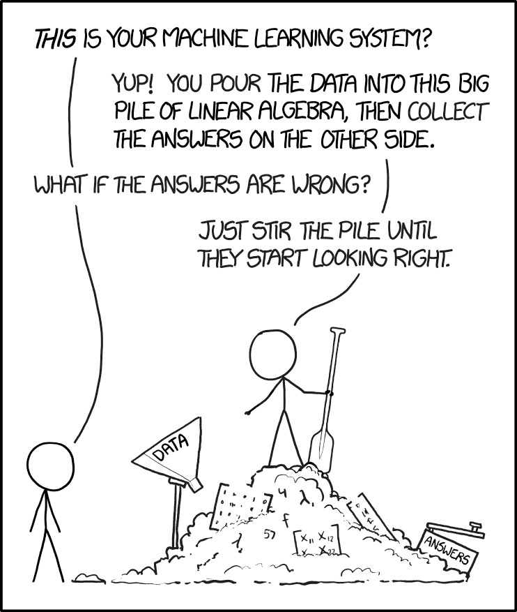
We can improve ML model based on explanation.
I know why the answer are wrong, so I can fix it.
With explainable ML
https://www.explainxkcd.com/wiki/index.php/1838:_Machine_Learning

Slide 5
Myth of Explainable ML
Goal of ML Explanation $≠$ you completely know how the ML model work
Human brain is also a Black Box!
People don’t trust network because it is Black Box, but you trust the decision of human!
Goal of ML Explanation is (my point of view)
Make people (your customers, your boss, yourself) comfortable.
讓人覺得爽
Personalized explanation in the future
Notes:
Give an example here?
說服別人：在導入機器學習方法來幫助專業人士判斷時，像是醫療或是法律等領域，十分重視理由。你總不會希望當醫生告訴你有病時，醫生說：「哦這是模型說的」。
說服自己：在建立模型後，透過樣本的可解釋性，可以幫助人類判斷，模型是否真的學到如人類所預期的事情。以下舉文中特別設計的案例為例。

Slide 6
Interpretable v.s. Powerful
Some models are intrinsically interpretable.
For example, linear model (from weights, you know the importance of features)
But ……. not very powerful.
Deep network is difficult to interpretable.
Deep network is a black box.
But it is more powerful than linear model …
Because deep network is a black box, we don’t use it.
削足適履 ☹
Let’s make deep network interpretable.
Notes:
(some people use this reason to against deep learning ☹)
“I showed him the matrix of weights of the seventh hidden layer of my Neural Network, but somehow he still didn’t get it.” — Anonymous Data Scientist
https://medium.com/@Pacmedhealth/ai-for-health-care-tackling-the-issue-of-interpretability-868be42aaf50

Slide 7
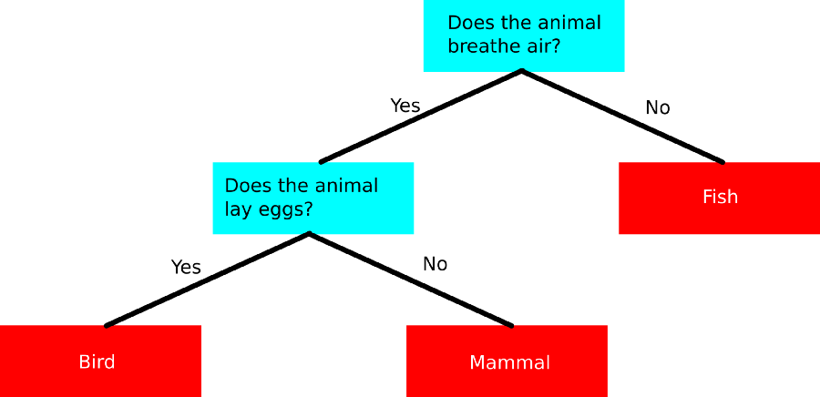
Interpretable v.s. Powerful
Are there some models interpretable and powerful at the same time?
How about decision tree?
Source of image: https://towardsdatascience.com/a-beginners-guide-to-decision-tree-classification-6d3209353ea
Notes:
“I showed him the matrix of weights of the seventh hidden layer of my Neural Network, but somehow he still didn’t get it.” — Anonymous Data Scientist
https://medium.com/@Pacmedhealth/ai-for-health-care-tackling-the-issue-of-interpretability-868be42aaf50

Slide 8
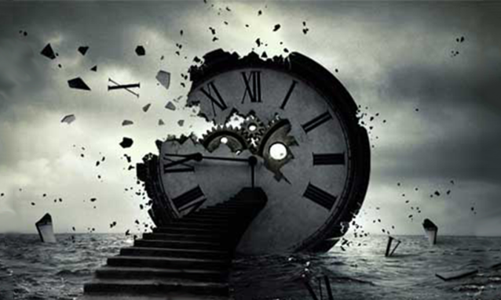
只要用 Decision Tree 就好了
今天這堂課就是在浪費時間 …

Slide 9
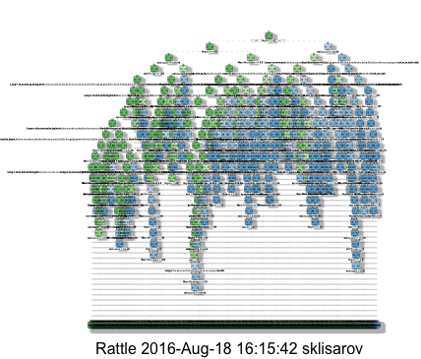
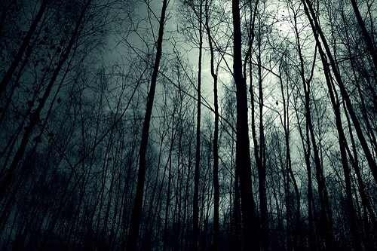
Interpretable v.s. Powerful
A tree can still be terrible!
We use a forest!
https://stats.stackexchange.com/questions/230581/decision-tree-too-large-to-interpret
Notes:
http://blog.datadive.net/interpreting-random-forests/

Slide 10
Local Explanation: Explain the Decision
Questions: Why do you think this image is a cat?

Slide 11
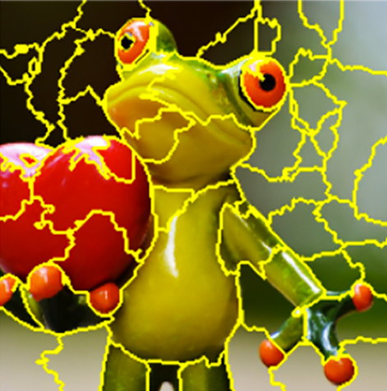
Basic Idea
Source of image: www.oreilly.com/learning/introduction-to-local-interpretable-model-agnostic-explanations-lime
Image: pixel, segment, etc.
Text: a word
Object $x$
Components:
$$\left\{x_{1},⋯,x_{n},⋯,x_{N}\right\}$$
We want to know the importance of each components for making the decision.
Idea: Removing or modifying the values of the components, observing the change of decision.
Large decision change
Important component
Notes:
The prediction difference is quantified by computing the difference between the model predicted probabilities with or without knowing
How to assinge the miss values

Slide 12
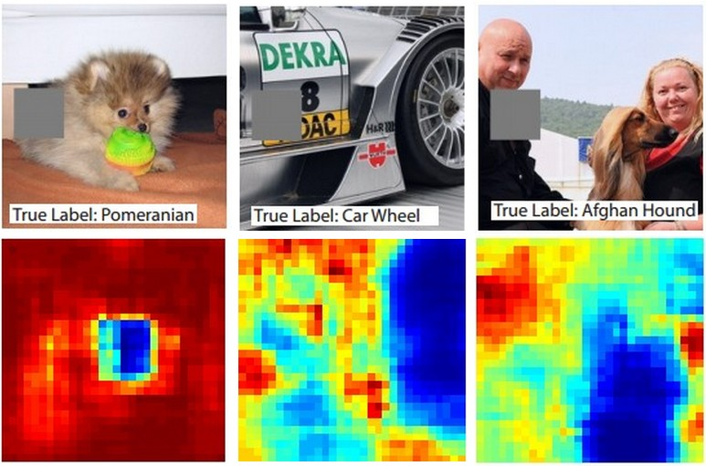
The size of the gray box can be crucial ……
Reference: Zeiler, M. D., & Fergus, R. (2014). Visualizing and understanding convolutional networks. In Computer Vision–ECCV 2014 (pp. 818-833)

Slide 13
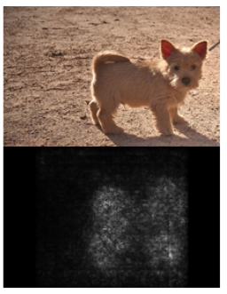
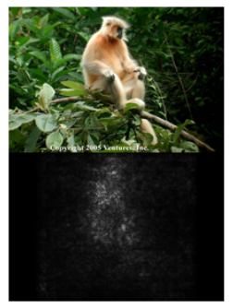
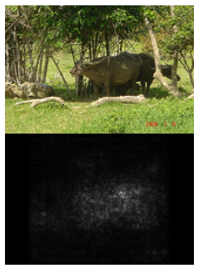
$$\left\{x_{1},⋯,x_{n},⋯,x_{N}\right\}$$
$$\left\{x_{1},⋯,x_{n}+∆x,⋯,x_{N}\right\}$$
$$y_{k}$$
$$y_{k}+∆y$$
$$|\frac{∂y_{k}}{∂x_{n}}|$$
$$|\frac{∆y}{∆x}|$$
$y_{k}$: the prob of the predicted class of the model
Saliency Map
Karen Simonyan, Andrea Vedaldi, Andrew Zisserman, “Deep Inside Convolutional Networks: Visualising Image Classification Models and Saliency Maps”, ICLR, 2014

Slide 14
Case Study: Pokémon v.s. Digimon
https://medium.com/@tyreeostevenson/teaching-a-computer-to-classify-anime-8c77bc89b881

Slide 15
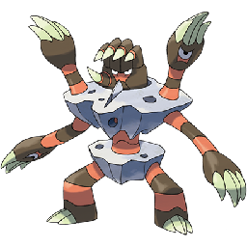
Task
Pokémon images: https://www.Kaggle.com/kvpratama/pokemon-images-dataset/data
Digimon images:
https://github.com/DeathReaper0965/Digimon-Generator-GAN
Pokémon
Digimon
Testing
Images:

Slide 16
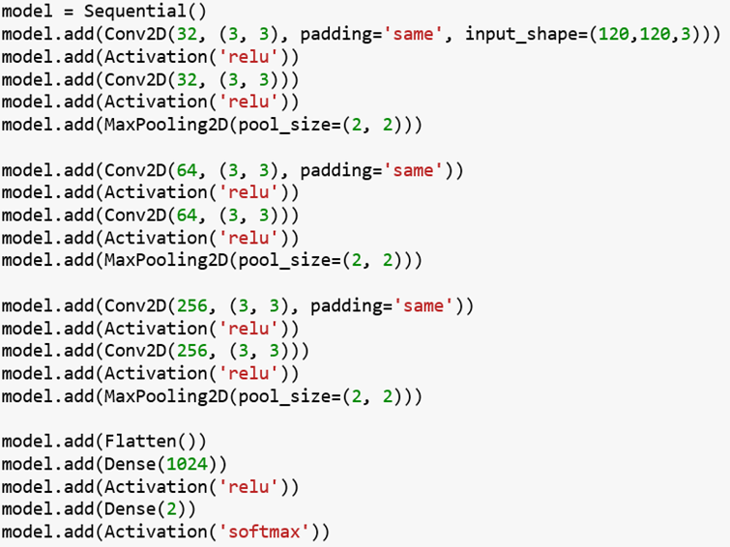
Experimental Results
Training Accuracy: 98.9%
太神啦!!!!!!
Testing Accuracy: 98.4%

Slide 17
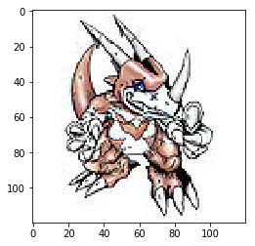
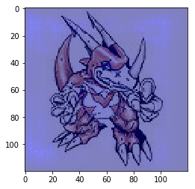
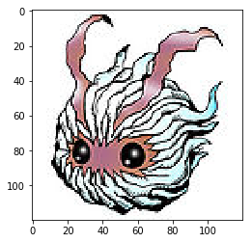
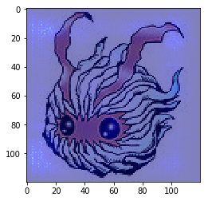
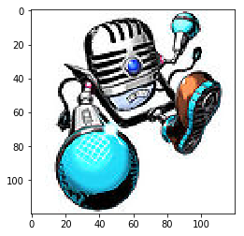
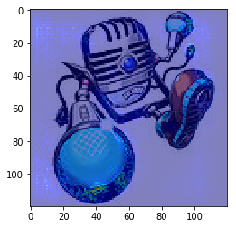
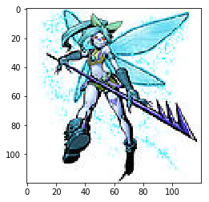
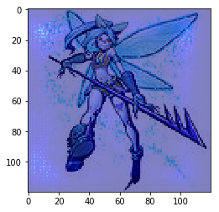
Saliency Map

Slide 18
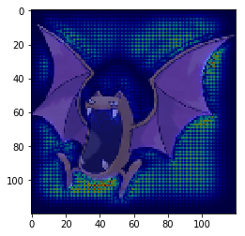
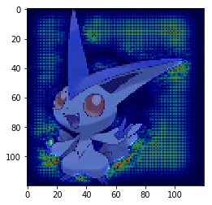
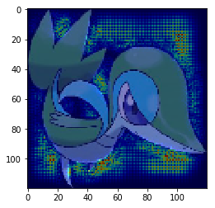
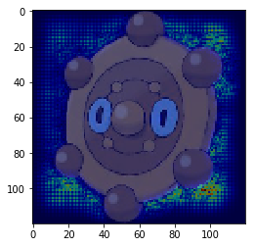
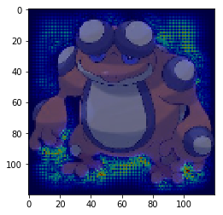
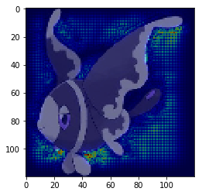
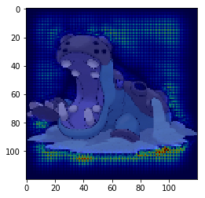
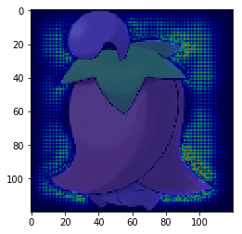
Saliency Map

Slide 19
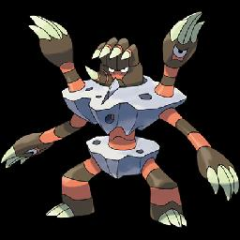
What Happened?
All the images of Pokémon are PNG, while most images of Digimon are JPEG.
PNG 檔透明背景
讀檔後背景是黑的!
Machine discriminate Pokémon and Digimon based on Background color.
This shows that explainable ML is very critical.
Notes:
temp = cv2.imread(pic)

Slide 20
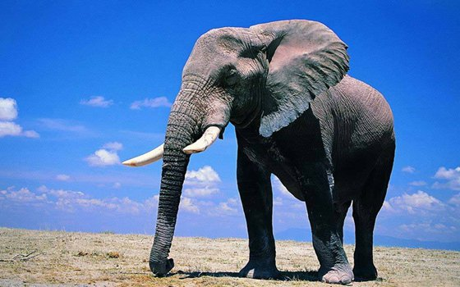
Limitation of Gradient based Approaches
To deal with this problem:
Gradient Saturation
Integrated gradient
(https://arxiv.org/abs/1611.02639)
大象
$\frac{∂\text{大象 }}{∂\text{鼻子長度 }}≈$0?
DeepLIFT (https://arxiv.org/abs/1704.02685)
鼻子長度
Notes:
DeepLIFT: ICML'17

Slide 21
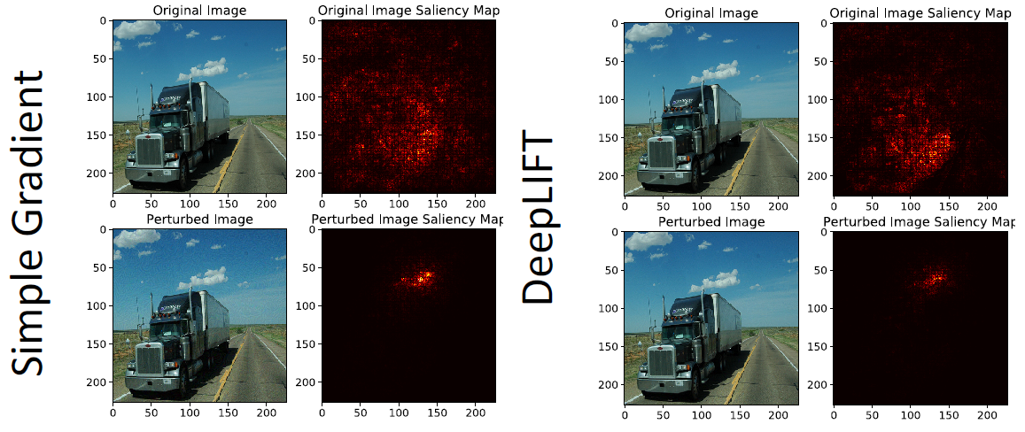
Attack Interpretation?!
https://arxiv.org/abs/1710.10547
It is also possible to attack interpretation…
Vanilla Gradient
Deep LIFT
The noise is small, and do not change the classification results.
Notes:
今年 2019 AAAIhttps://arxiv.org/abs/1710.10547

Slide 22
Global Explanation: Explain the whole Model
Question: What do you think a “cat” looks like?
Notes:
Basic
Regularization
Plug & play
Deconvoluation
DT
Future work

Slide 23
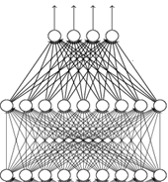
Activation Minimization (review)
input
$$x^{∗}=arg\max_{x}{y_{i} }$$
Can we see digits?
Convolution
Max Pooling
0
1
2
Convolution
Max Pooling
3
4
5
flatten
6
7
8
Deep Neural Networks are Easily Fooled
https://www.youtube.com/watch?v=M2IebCN9Ht4
$$y_{i}$$
Digit

Slide 24
Activation Maximization
$$x^{∗}=arg\max_{x}{y_{i} }$$
Possible reason
?

Slide 25
Activation Minimization (review)
Find the image that maximizes class probability
The image also looks like a digit.
$$x^{∗}=arg\max_{x}{y_{i}}$$
$$+ R\left(x\right)$$
$$x^{∗}=arg\max_{x}{y_{i}}$$
$$R\left(x\right)=−\sum_{i,j}{\left|x_{ij}\right|}$$
How likely $x$ is a digit
0
1
2
3
4
5
6
7
8

Slide 26
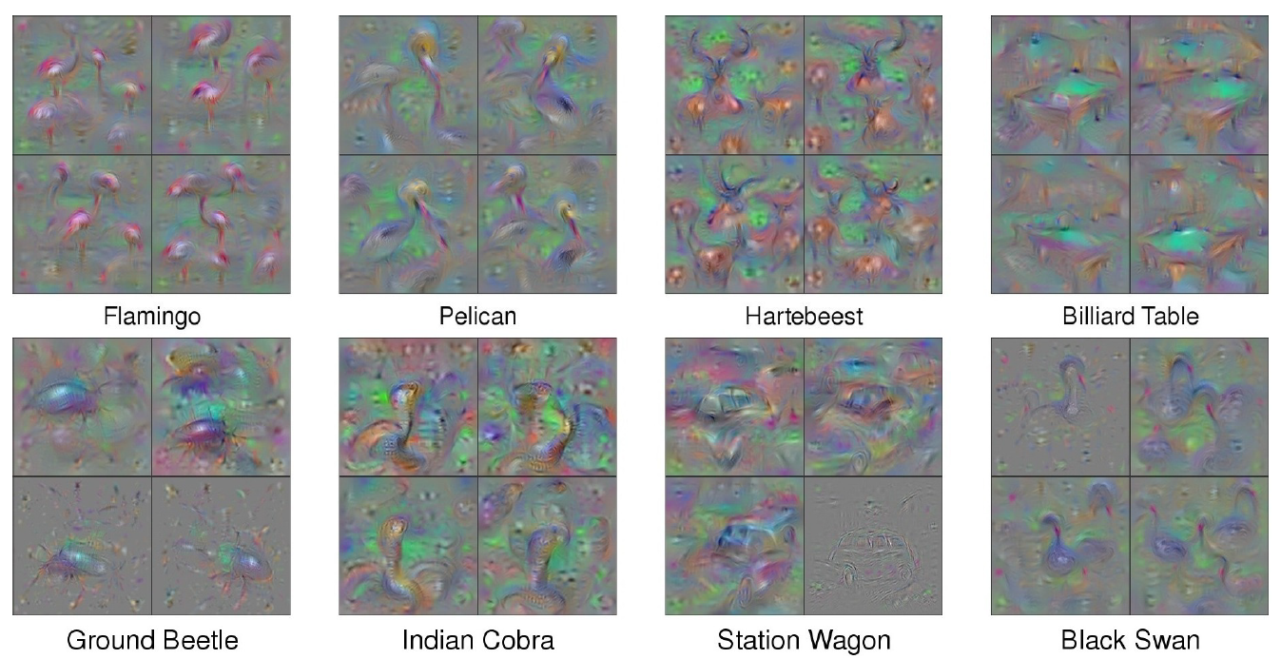
With several regularization terms, and hyperparameter tuning …..
https://arxiv.org/abs/1506.06579

Slide 27
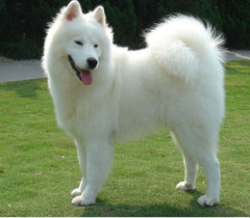
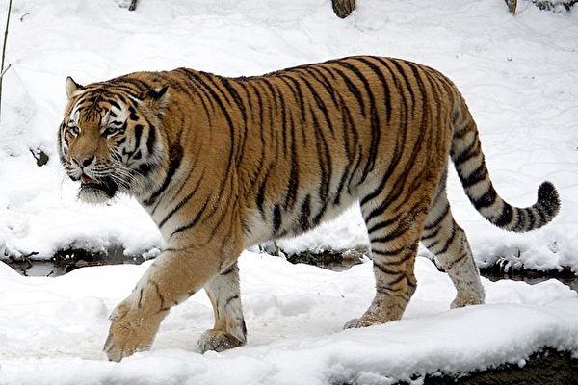
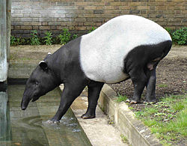
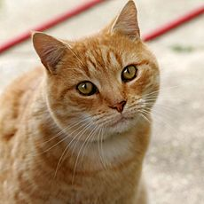
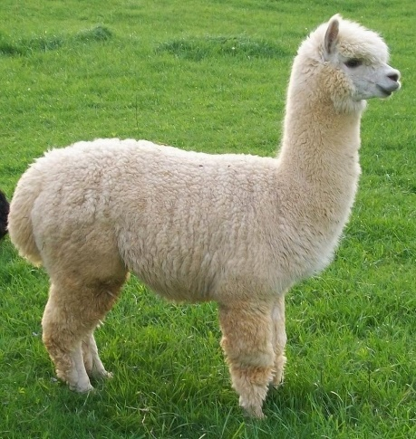
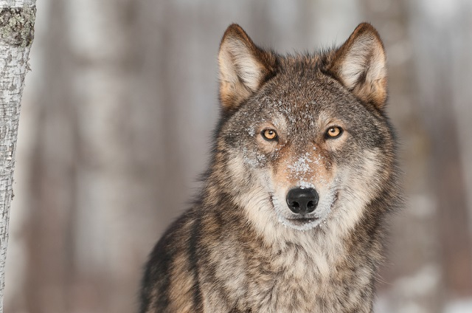
Constraint from Generator
(Simplified Version)
Training a generator
(by GAN, VAE, etc.)
low-dim
vector
Image Generator
Image
$$x$$
$$z$$
$$G$$
$$x=G\left(z\right)$$
Training Examples
Show image:
$$x^{∗}=arg\max_{x}{y_{i}}$$
$$z^{∗}=arg\max_{z}{y_{i}}$$
$$x^{∗}=G\left(z^{∗}\right)$$
Image Generator
Image
$$x$$
Image Classifier
$$z$$
$$y$$

Slide 28
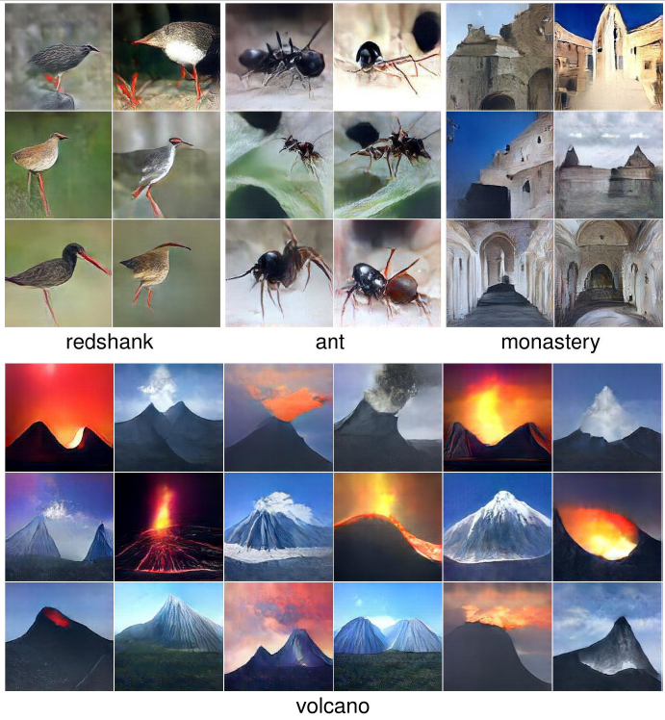
https://arxiv.org/abs/1612.00005

Slide 29
Using A Model to Explain Another
Some models are easier to Interpret.
Using interpretable model to mimic uninterpretable models.

Slide 30
Using a model to explain another
Using an interpretable model to mimic the behavior of an uninterpretable model.
Black
Box
$$x^{1},x^{2},⋯,x^{N}$$
$$y^{1},y^{2},⋯,y^{N}$$
(e.g. Neural Network)
as close as possible
$$⋯⋯$$
Linear
Model
$$x^{1},x^{2},⋯,x^{N}$$
$${\tilde{y}}^{1},{\tilde{y}}^{2},⋯,{\tilde{y}}^{N}$$
Problem: Linear model cannot mimic neural network …
However, it can mimic a local region.

Slide 31
Local Interpretable Model-Agnostic Explanations (LIME)
1. Given a data point you want to explain
$$y$$
2. Sample at the nearby
3. Fit with linear model (or other interpretable models)
4. Interpret the linear model
Black
Box
$$x$$

Slide 32
Local Interpretable Model-Agnostic Explanations (LIME)
1. Given a data point you want to explain
$$y$$
2. Sample at the nearby
3. Fit with linear model (or other interpretable models)
4. Interpret the linear model
Black
Box
$$x$$

Slide 33
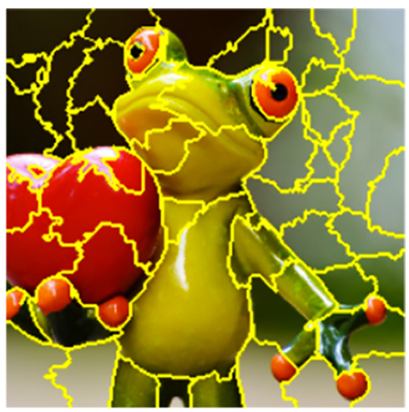
LIME － Image
1. Given a data point you want to explain
2. Sample at the nearby
Each image is represented as a set of superpixels (segments).
Randomly delete some segments.
Black
Black
Black
Compute the probability of “frog” by black box
0.85
0.52
0.01
Ref: https://medium.com/@kstseng/lime-local-interpretable-model-agnostic-explanation-%E6%8A%80%E8%A1%93%E4%BB%8B%E7%B4%B9-a67b6c34c3f8

Slide 34
LIME － Image
3. Fit with linear (or interpretable) model
$$x_{1}$$
$$⋯⋯$$
$$x_{m}$$
$$⋯⋯$$
$$x_{M}$$
Extract
Extract
Extract
$$x_{m}=\left\{\begin{aligned}0 \\ &1\end{aligned}\right.$$
Segment m is deleted.
Linear
Linear
Linear
Segment m exists.
$$M$$
is the number of segments.
0.85
0.52
0.01

Slide 35
LIME － Image
4. Interpret the model you learned
$$y=w_{1}x_{1}+⋯+w_{m}x_{m}+⋯+w_{M}x_{M}$$
$$x_{m}=\left\{\begin{aligned}0 \\ &1\end{aligned}\right.$$
Segment m is deleted.
Segment m exists.
Extract
$$M$$
is the number of segments.
If $w_{m}≈0$
segment m is not related to “frog”
Linear
If $w_{m}$ is positive
segment m indicates the image is “frog”
If $w_{m}$ is negative
0.85
segment m indicates the image is not “frog”
Notes:
If $w_{m}$ is negative
segment m indicate the image is not “frog”

Slide 36
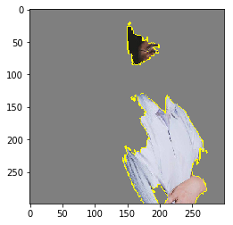
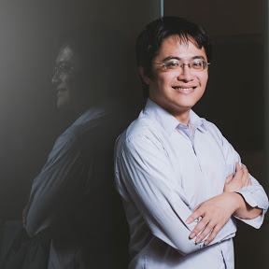
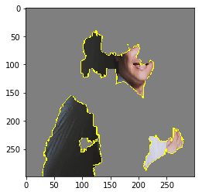
LIME - Example
實驗袍
和服：0.25
實驗袍：0.05
和服

Slide 37
Decision Tree
$$O\left(T_{θ}\right)$$
: how complex $T_{θ}$ is
e.g. average depth of $T_{θ}$
Using an interpretable model to mimic the behavior of an uninterpretable model.
Black
Box
$$x^{1},x^{2},⋯,x^{N}$$
$$y^{1},y^{2},⋯,y^{N}$$
$$θ$$
(e.g. Neural Network)
as close as possible
$$⋯⋯$$
Decision
Tree
$$x^{1},x^{2},⋯,x^{N}$$
$${\tilde{y}}^{1},{\tilde{y}}^{2},⋯,{\tilde{y}}^{N}$$
$$T_{θ}$$
We want small $O\left(T_{θ}\right)$
Problem: We don’t want the tree to be too large.

Slide 38
Decision Tree – Tree regularization
https://arxiv.org/pdf/1711.06178.pdf
Train a network that is easy to be interpreted by decision tree.
$T_{θ}$ : tree mimicking network with parameters $θ$
$$O\left(T_{θ}\right)$$
: how complex $T_{θ}$ is
$$θ^{∗}=arg\min_{θ}{L\left(θ\right)}$$
$$+ λO\left(T_{θ}\right)$$
Original loss function for training network
Preference for network parameters
Tree Regularization
Is the objective function with tree regularization differentiable? No! Check the reference for solution.
Notes:
Thus we want a small DT, or to be more precise, we want a DT that on average gives us simple explanations. Let me call ‘path length’ the length of the path that an example must travel from the root to reach its designated leaf. In a nutshell, we want a DT that has low Average Path Length (APL), where the average here means average over all the examples we want to classify.
Stanford University AAAI 2018
https://medium.com/@Pacmedhealth/ai-for-health-care-tackling-the-issue-of-interpretability-868be42aaf50
http://www.shallowmind.co/jekyll/pixyll/2017/12/30/tree-regularization/

Slide 39
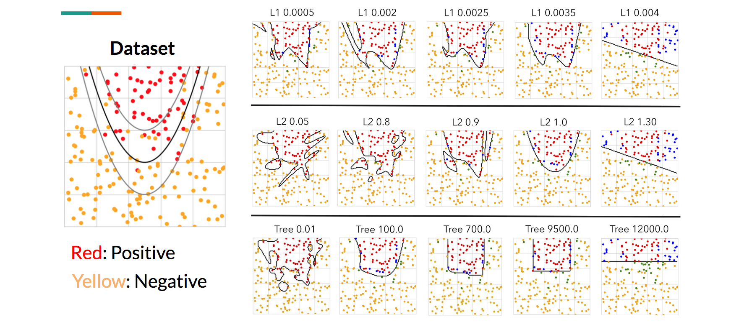
Decision Tree – Experimental Results
Notes:
Figure 7: Toy parabola dataset - we train a deep MLP with different levels of L1, L2, and Tree regularization to examine visual differences between the final decision boundaries. The key point here is that tree regularization produces axis aligned boundaries.

Slide 40
Concluding Remarks
This is a “cat”.
Because …
Classifier
Local Explanation
Why do you think this image is a cat?
Global Explanation
What do you think a “cat” look like?
Using an interpretable model to explain an uninterpretable model
Notes:
說出為什麼「我知道」
舉個範例，現在要透過量測病患的某些身理指標數字，來判斷該用戶是否會感冒。以 Overall Feature Importance 而言，可能「發高燒」會是最重要的特徵 (代表透過「發高燒」這個特徵可以把整體病患分得最開)；但對於某個病患 (小明)，他並沒有發燒，但他有流鼻水，所以也被預測為感冒，那對於小明這個樣本而言，將他預測為感冒的原因，就不是發高燒，而是流鼻水了。

